Slide 1
WOLVES CLUB BASEBALL
UWGWOLVES.weebly.com

Slide 2
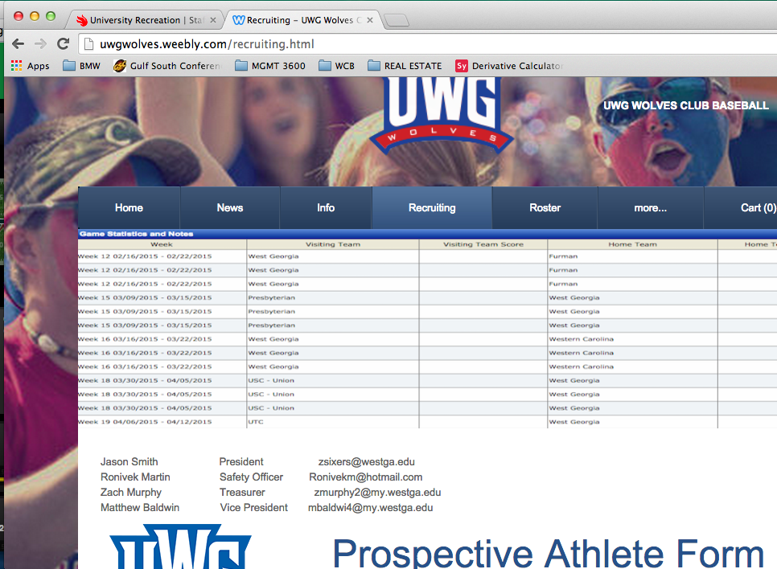
Welcome
Player profiles
Uwgwolves.weebly.com/Recruiting
Prospective Athlete Form
Print and fill out or Sign and Email
Contact Information

Slide 3
Executive Members
President – Jason Smith
Club Sports Director – Jon Corum
VP – Matt Baldwin
Treasurer –
Safety Officer - Vic Martin

Slide 4
Who are we?
UWG Club Baseball
National Club Baseball Association
A competitive alternative to NCAA

Slide 5
History of Wolves Club Baseball
Founded in Spring 2014

Slide 6
Purpose
A chance to play competitive baseball
Getting involved
Grow as individual and as a club member in a competitive environment.
What should you expect from us?
Organization
Flexibility
Voice
Respect

Slide 7
What do we expect from you?
Full commitment
To be present at all meetings, Saturdays, and Sundays
Positively represent club
Respect to fellow teammates
Willingness to help

Slide 8
When and where do we play?
Saturday and Sunday nights, Intramural Fields
Games, practices, or other team events
Other team’s fields
Plan on traveling three or four weekends
Usually start around 5p.m.

Slide 9
Internet & Social Media
UWGWolves.weebly.com
Find all information, Forms, Dates, Updates
Twitter
@UWGClubBaseball
Facebook
www.facebook.com/UWGbaseball
Team Email
Zsixers@westga.edu

Slide 10
Important info!
Jason Smith: 404.626.7346
Ronivek Martin : Ronivekm@hotmail.com
Matthew Baldwin: mbaldwi4@my.westga.edu
Bring your SPRING schedule with you to the next meeting or email to Jason Smith
**Player profiles must be turned in to be able to try out!**

Slide 11
Thank you for your interest
Questions, comments, concerns??
Feel free to contact any executives with any questions you have

